Slide 1
Immunodietica Tissue-Expression Weekly Update
Week of August 5^{th,} 2019

Slide 2
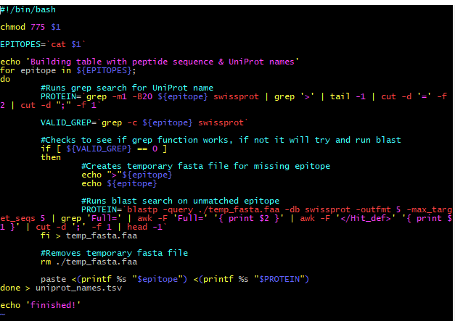
Automation Pipeline (Unix)
Takes txt file with list epitopes as input and converts them to fasta format for BlastP
Utilizes grep (bash) function to find UniProt name of proteins that contain perfect match of peptide string
If peptide cannot be found, runs Blastp to find protein with highest percent similarity in identity
Runs latest version BlastP using same parameters as the online version
Produces dataframe with epitope and the corresponding UniProt protein names
Can be uploaded to any database site to convert to either EnsembleID or Gene Symbol (required as input for the R Script)

Slide 3
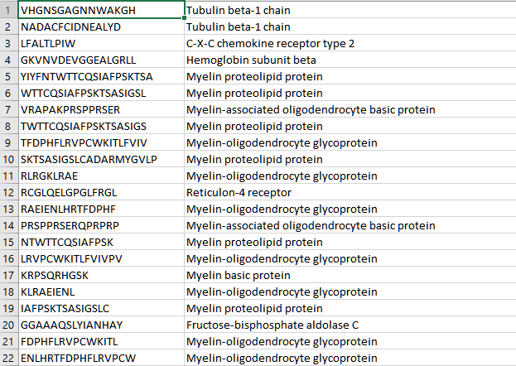
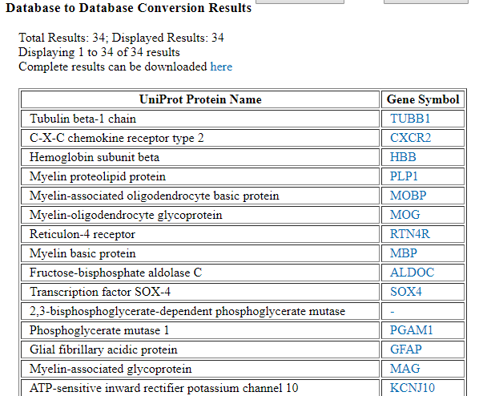
Run UniProt Names Through Database Converter
Plan on eventually doing database conversion locally within the pipeline

Slide 4
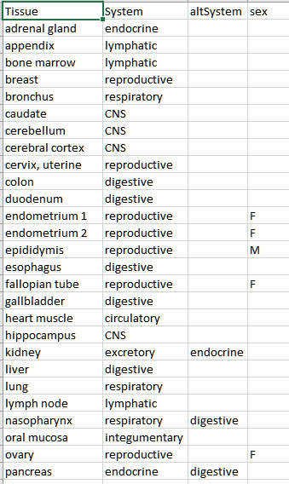
Reduction of Tissue System Terms
Used database from protein atlas
Started off with 58 unique locations for tissue-specificity
Reduced all tissues/organs to 11 different types of organ systems
If epitope is found in all 11, a function removes those entries and labels it as ubiquitous instead

Slide 5
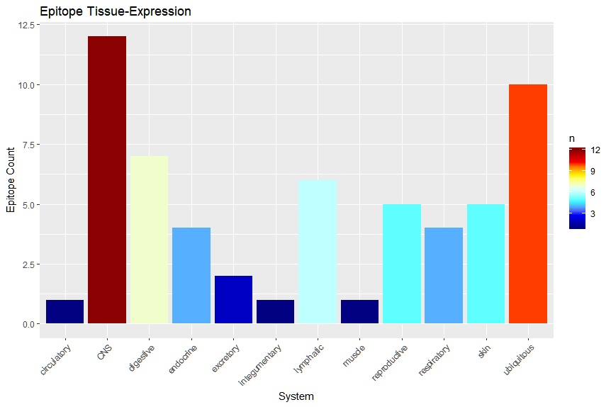
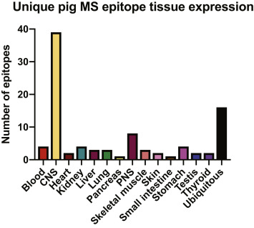
Generates bar plot which bins epitopes based on expression within each tissue system
Currently bar plot ignores expression-level (treats all expression level as the same value)
Need to fix: Total epitope count is halved because different UniProt names that map to the same gene symbol during database conversion are only listed once (no duplicate gene symbols)

